Slide 1
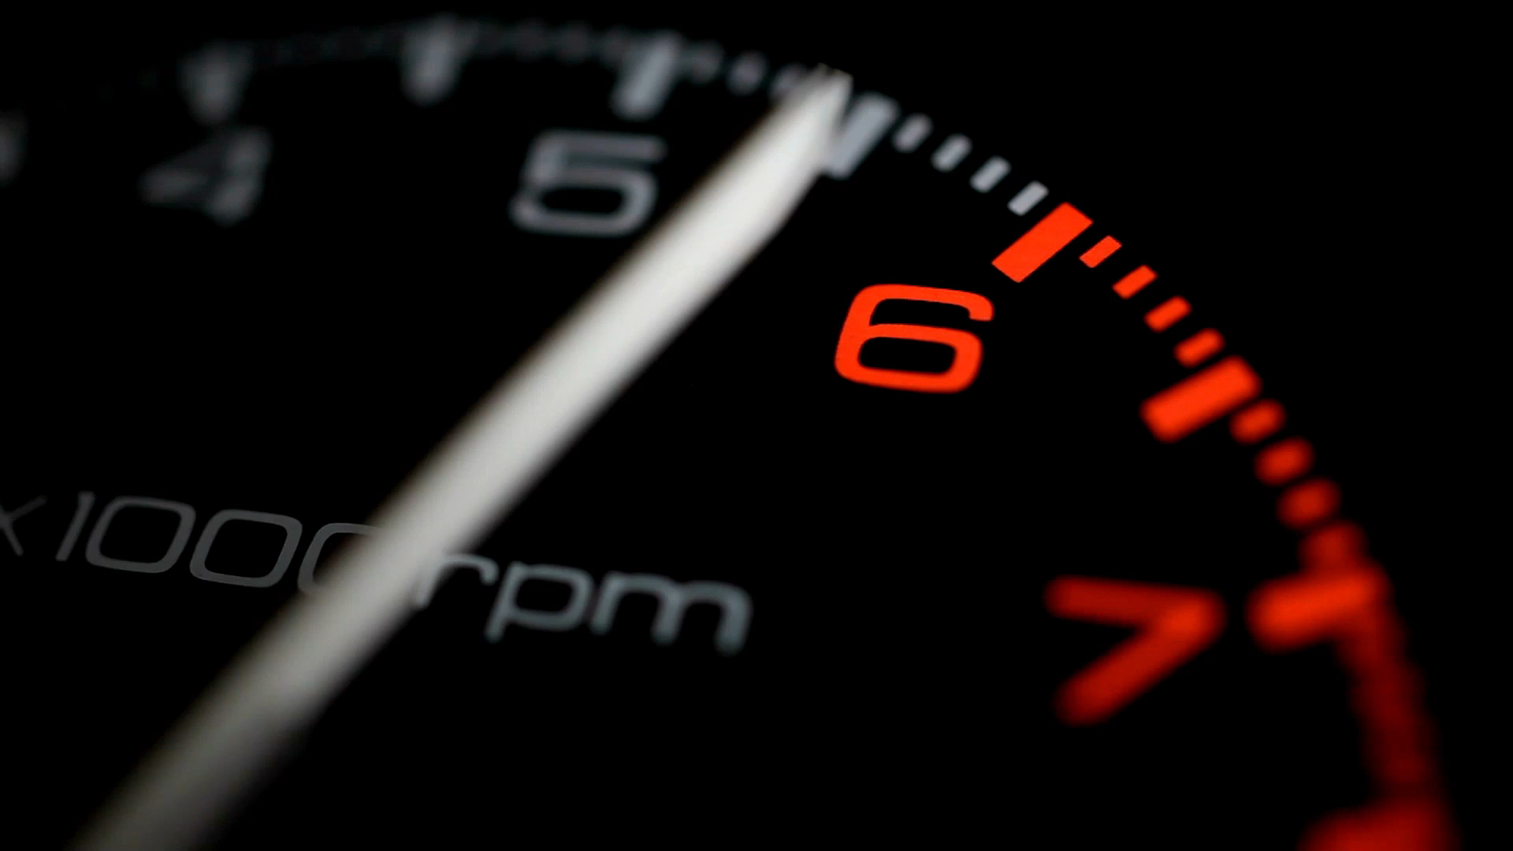
Yet Another VU-meter
A self-training project

Slide 2


Step 1 – Accessing sound info & microphone
Simple configuration file
Simple command line
Select sound card (Mixer.Info)
Access line level (DataLine.Level)
Display level as text
Console
PC
config
app
JVM
Not implemented
/ library bug?
Win64
https://www.youtube.com/watch?v=T52l6ss3SFs
https://docs.oracle.com/javase%2Ftutorial%2F/sound/accessing.html
https://docs.oracle.com/javase/tutorial/sound/sampled-overview.html

Slide 3
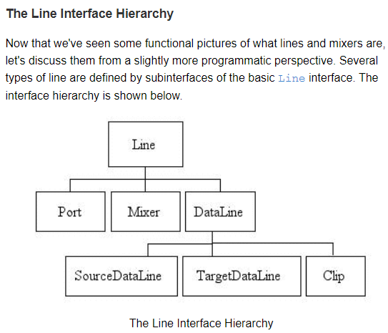
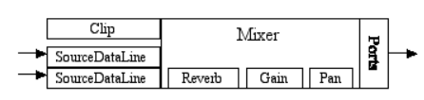
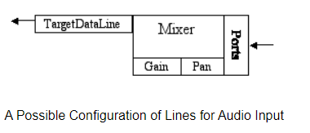

Slide 4
Limitations
DataLine.Level not implemented -> monitor buffer
Output ports cannot be monitored -> duplicate to input (virtual microphone)
eclipse 2023-12 will not say if the default JDK is too old (make sure the system’s JDK is 17+)

Slide 5
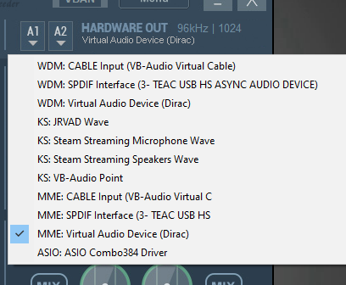
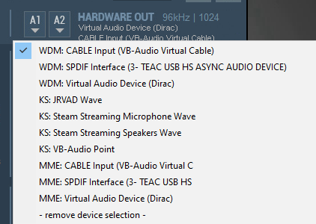
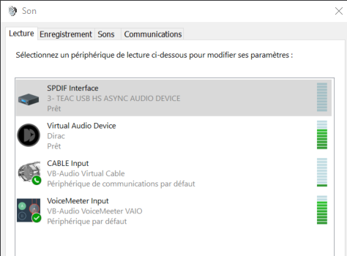

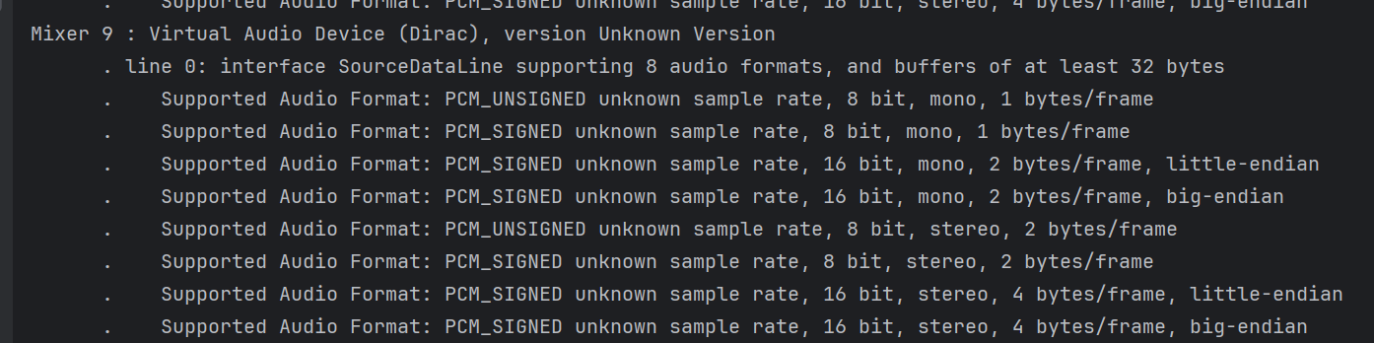
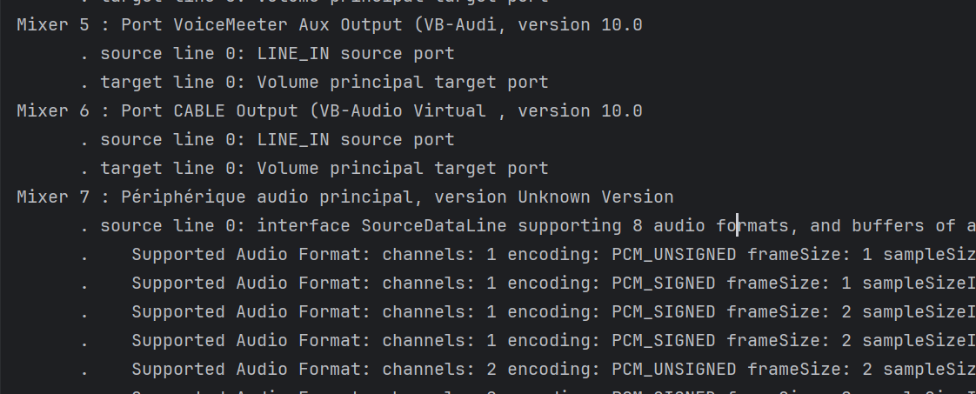
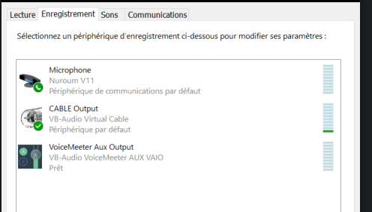
Step 2 – Accessing audio output
Create virtual output device that redirects sound to virual microphone
Duplicate and redirect
Virtual
output
device
forward
Actual audible output
VUMeter input virtual microphone
https://vb-audio.com/Voicemeeter/index.htm

Slide 6
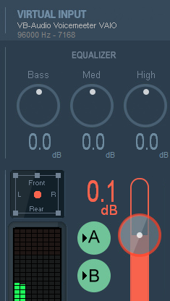
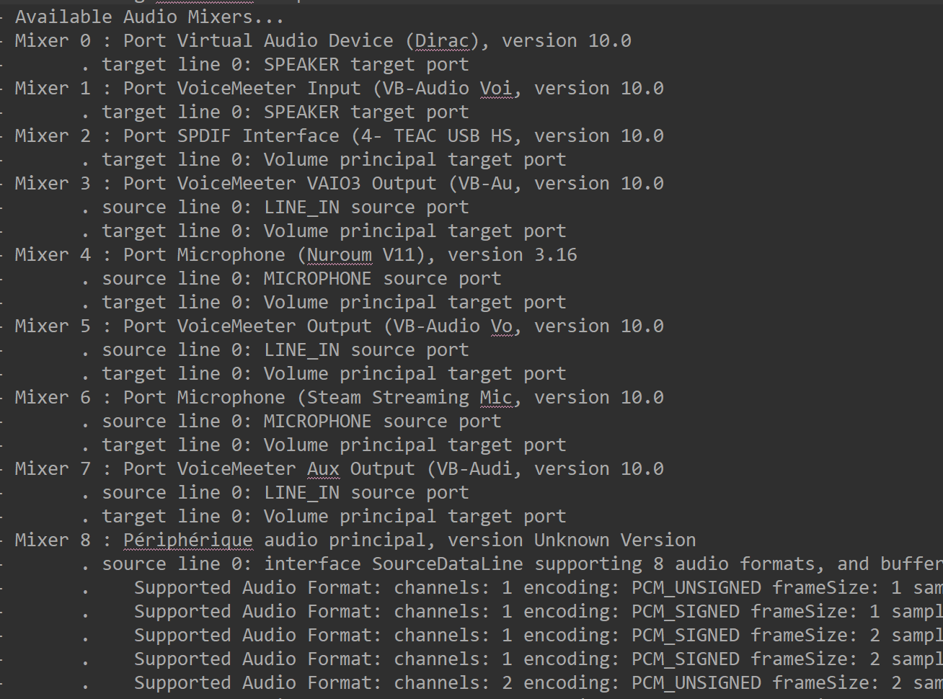
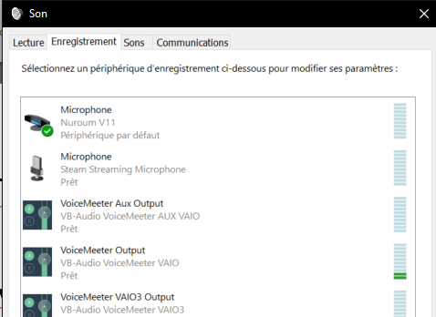
Step 2 – Accessing audio output (without additional CABLE in/out mapping)
Create virtual output device that redirects sound to virual microphone
Duplicate and redirect
Virtual
output
device
forward
Actual audible output
VUMeter input virtual microphone
https://vb-audio.com/Voicemeeter/index.htm

Slide 7
Limitations
IDE: free IntelliJ licences might not be granted -> migrate to Eclipse → https://www.youtube.com/watch?v=iFa5dMUpWCE
Create project from Eclipse
Register into git/github:
cd <<project repository>>
git init
git add . git commit -m" first commit“ git branch -M main
git remote add origin https://github.com/devidin/yavumeter.git
git push -u origin main
https://www.youtube.com/watch?v=gO20QGT6aW8

Slide 8
Secured authentication
Cf. https://www.youtube.com/watch?v=XFgol-F9cnc

Slide 9
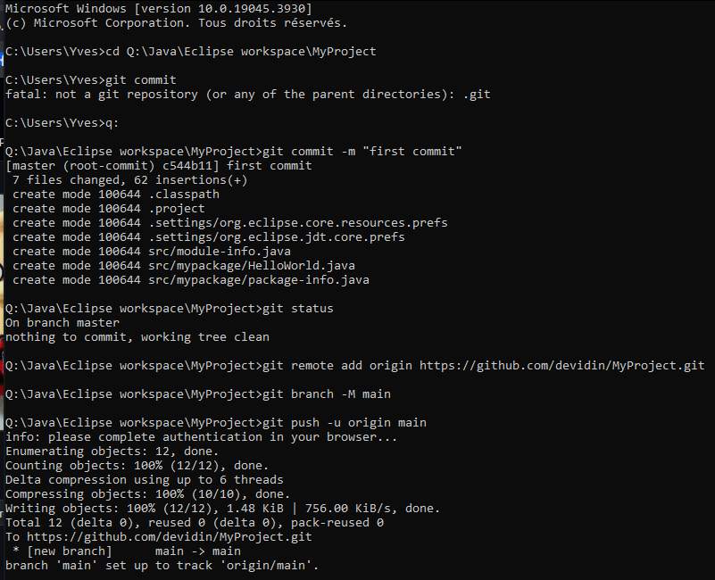
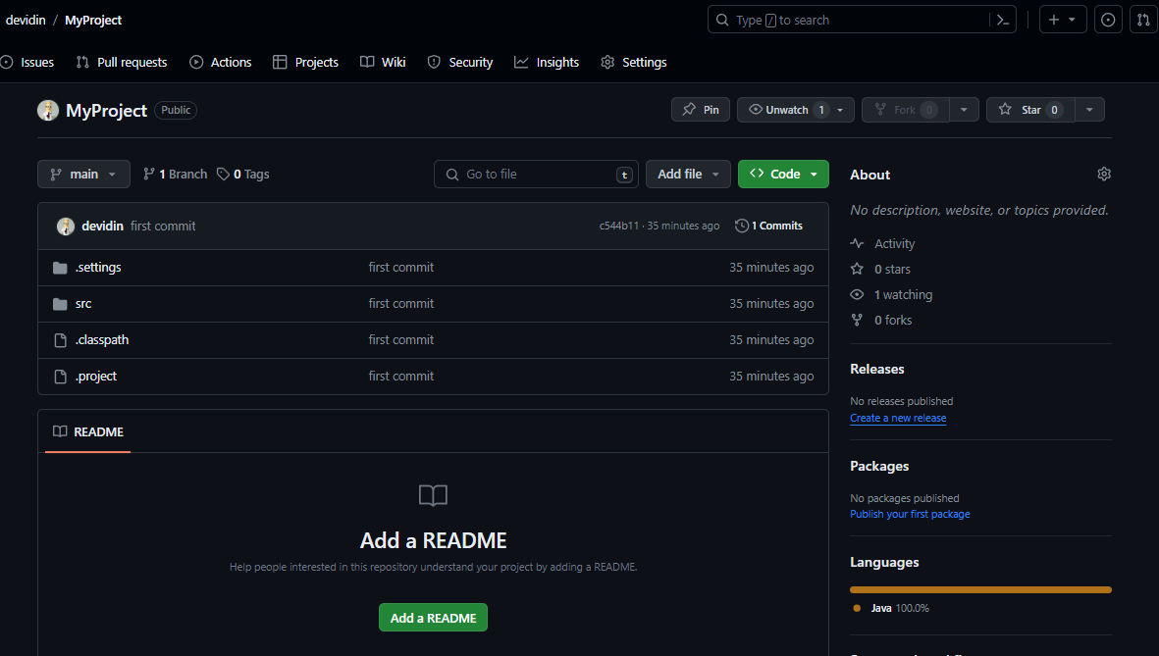
GitHub : start from scratch

Slide 10
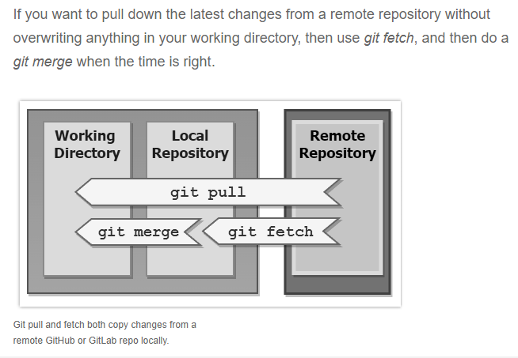
Aligning code with github

Slide 11
Limitations
Requires logging → integrate with log4J or equivalent
Requires configuration

Slide 12
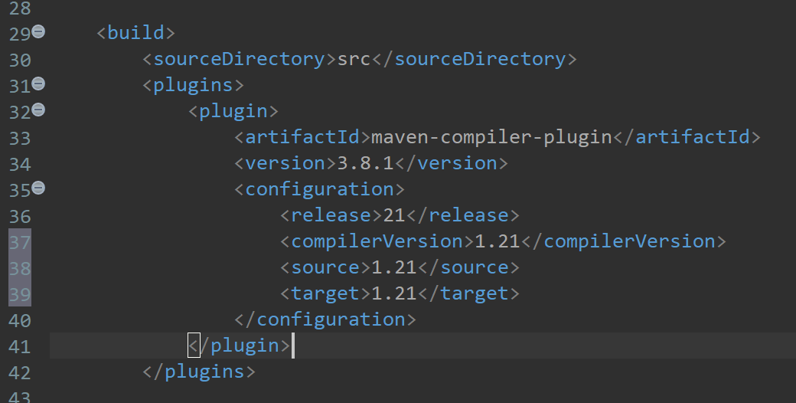
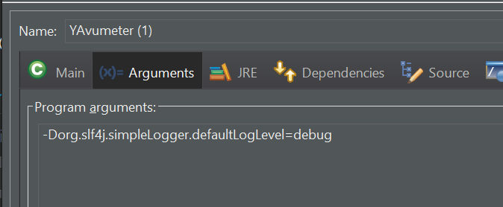
Logging
Alternatives: Log4j, Log4j 2, Logback+ SL4J (https://www.baeldung.com/java-logging-intro)
Selection: SL4J+Logback because provides a common interface and abstraction for most of the Java logging frameworks. https://www.baeldung.com/logback
Requires to convert to Maven project
Specify compilation option in pom.xml:
Configure SL4J/logback: https://logback.qos.ch/setup.html

Slide 13
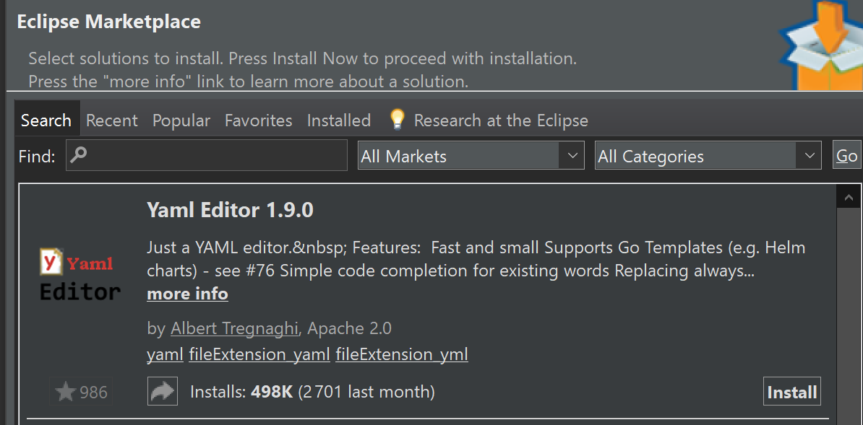
Configuration
Selected solution: snakeyaml
Eclipse plugin :
https://marketplace.eclipse.org/content/liclipsetext
Note: https://github.com/de-jcup/update-site-eclipse-yaml-editor/tree/main is not working... (failed to connect from eclipse)

Slide 14
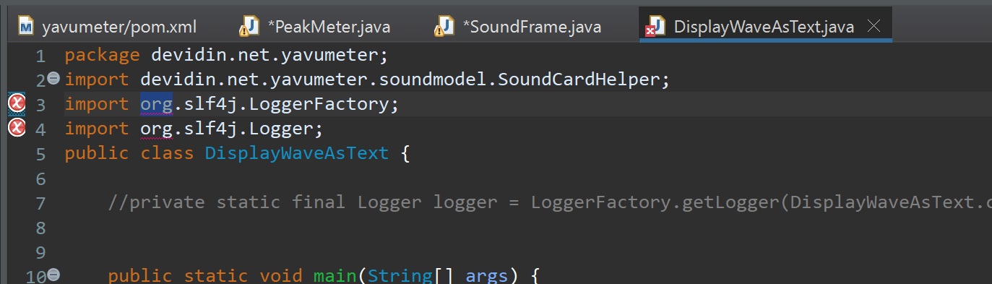
Libraries not accessible

Slide 15
Step 3 – Graphical representation
Console output too slow → requires graphical representation (cf.
Console output too slow → requires graphical representation (cf.
GUI Framework: JavaFX

Slide 16
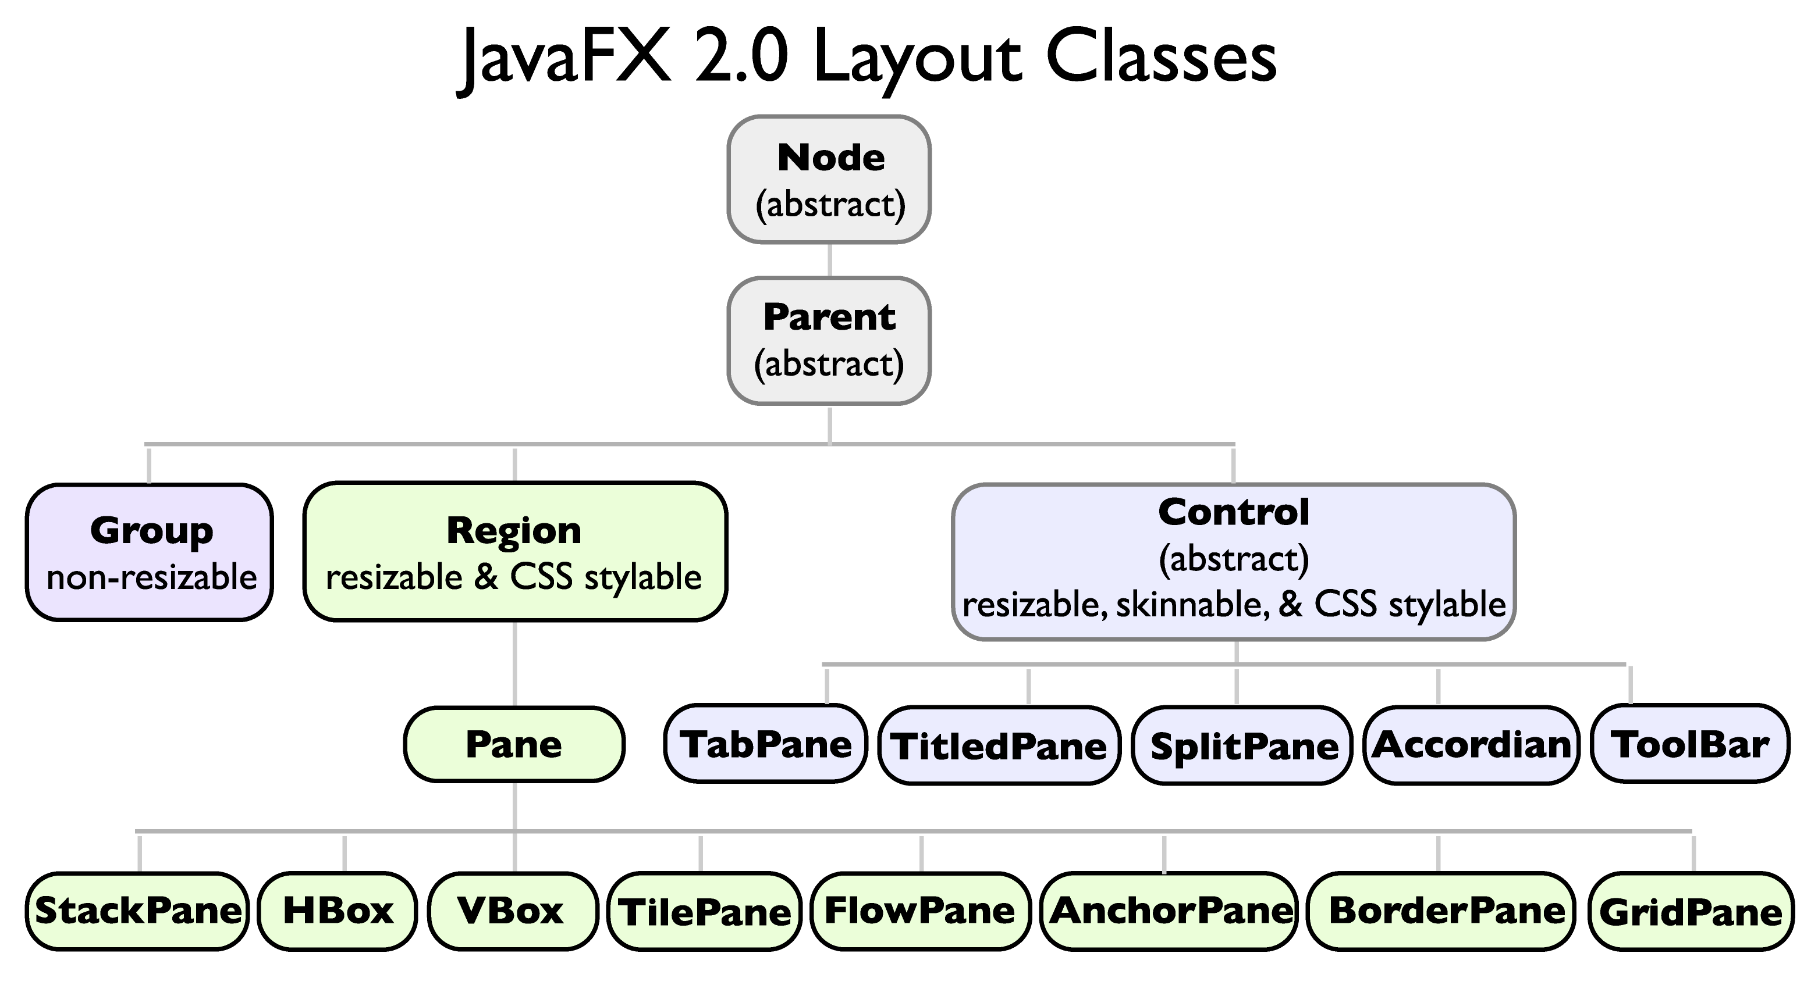
JavaFX components
Stage: container
https://medium.com/@rafaelgurgel/javafx-basic-concepts-9b40c271e78a#:~:text=JavaFX%20has%20works%20with%20four,%2C%20Scene%2C%20Node%20and%20Layout.&text=Is%20the%20central%20element%2C%20acting,space%20where%20everything%20happens%20inside
Scene: group of nodes
Scene: group of nodes
Scene: group of nodes
Scene: group of nodes
Layout: how to show nodes & elements
Layout: how to show nodes & elements
Layout: how to show nodes & elements
UIcontrol: label, button, …
UIcontrol: label, button, …
UIcontrol: label, button, …

Slide 17
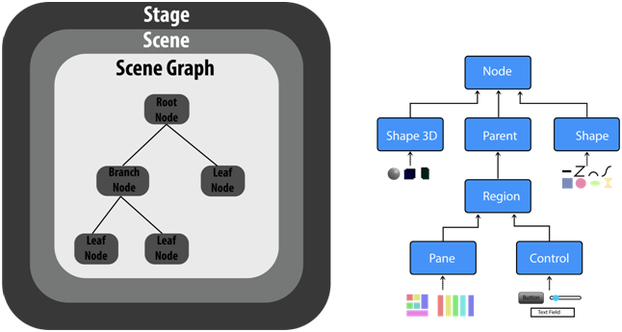

Slide 18
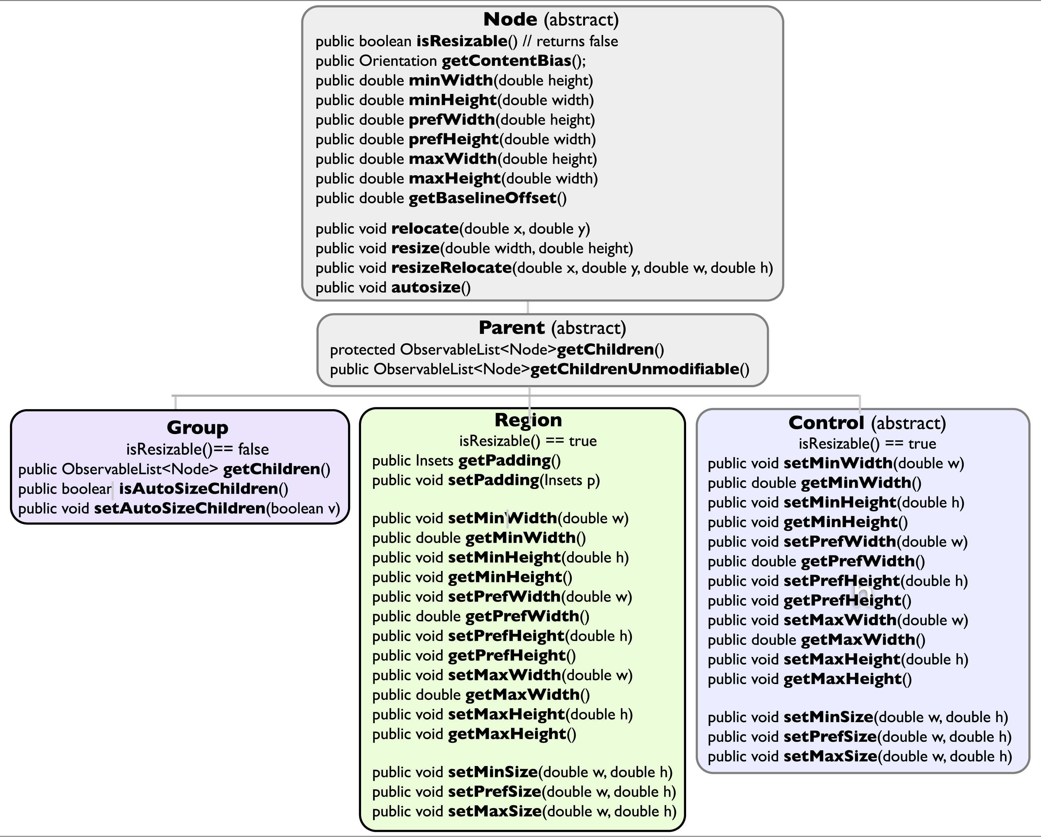

Slide 19
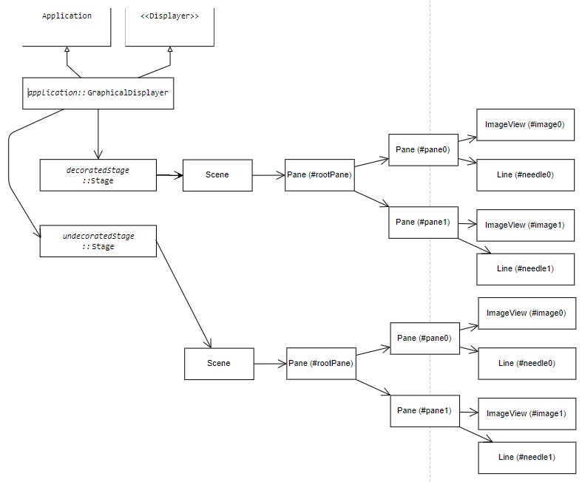
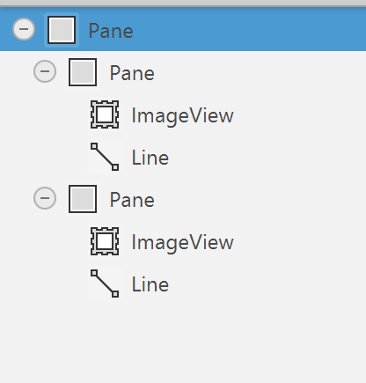
Javafx class diagram
FMX
https://gitmind.com/app/docs/f64imf33

Slide 20
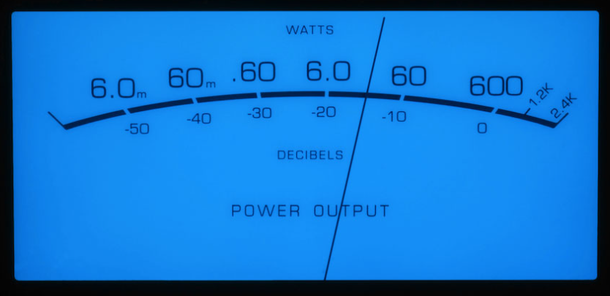
Graphical representation - layout
height
needleLength
minAngle
width
maxAngle

Slide 21
Graphical representation - coordinates
(0,0)
needleLength
Min (xMin, yMin)
Max (xMax, yMax)
minAngle
height
width
maxAngle
C (xC, yC)

Slide 22
Graphical representation - calculations
Input
Background → width, height
Configuration
xC (default = width/2)
yC (default = -height / 5)
xMin (default = witdh/10)
yMin (default = height/3)
xMax (default = 9*width/10)
yMax : (default = 9*width/10)
needleRed = 0..255 (default = 0)
needleGreen = 0..255 (default = 0)
needleBlue = 0..255 (default = 0)
Calculations
needleLength = avg(sqrt( (xMin-xC)² + (yMin-yC)² ), sqrt( (xMax-xC)² + (yMax-yC)²)
(redundant inputs, possibly 2 different needle lengths → use average)
minAngle = arccos((xMin – xC) / needleLength)

Slide 23
Graphical representation - coordinates
Min (xMin, yMin)
→ Use atan2()
minAngle
xMin – xC
cosMin =
needleLength
needleLength
C (xC, yC)

Slide 24
Graphical representation - coordinates
Max (xMax, yMax)
→ Use atan2()
yMax – yC
sinMax =
needleLength
maxAngle
needleLength
C (xC, yC)

Slide 25
Min (xMin, yMin)
minAngle
C (xC, yC)
→ Use atan2()
xMin – xC
cosMin =
needleLength
needleLength

Slide 26
C (xC, yC)
→ Use atan2()
maxAngle
xMax – xC
cosMax =
needleLength
needleLength
Max (xMax, yMax)

Slide 27
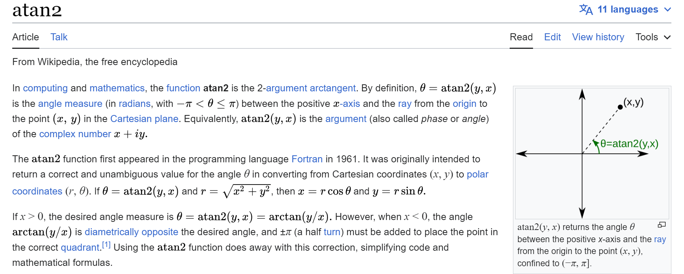
Graphical representation - calculations
Calculations
maxAngle = arccos((xMax – xC) / needleLength)
or
maxAngle = arcsin((yMax – yC) / needleLength)
yMax = yC + needleLength * sin (maxAngle)
https://en.wikipedia.org/wiki/Atan2
max(min)Angle = atan2(yMax(Min) – yC, xMax(Min)– xC)

Slide 28
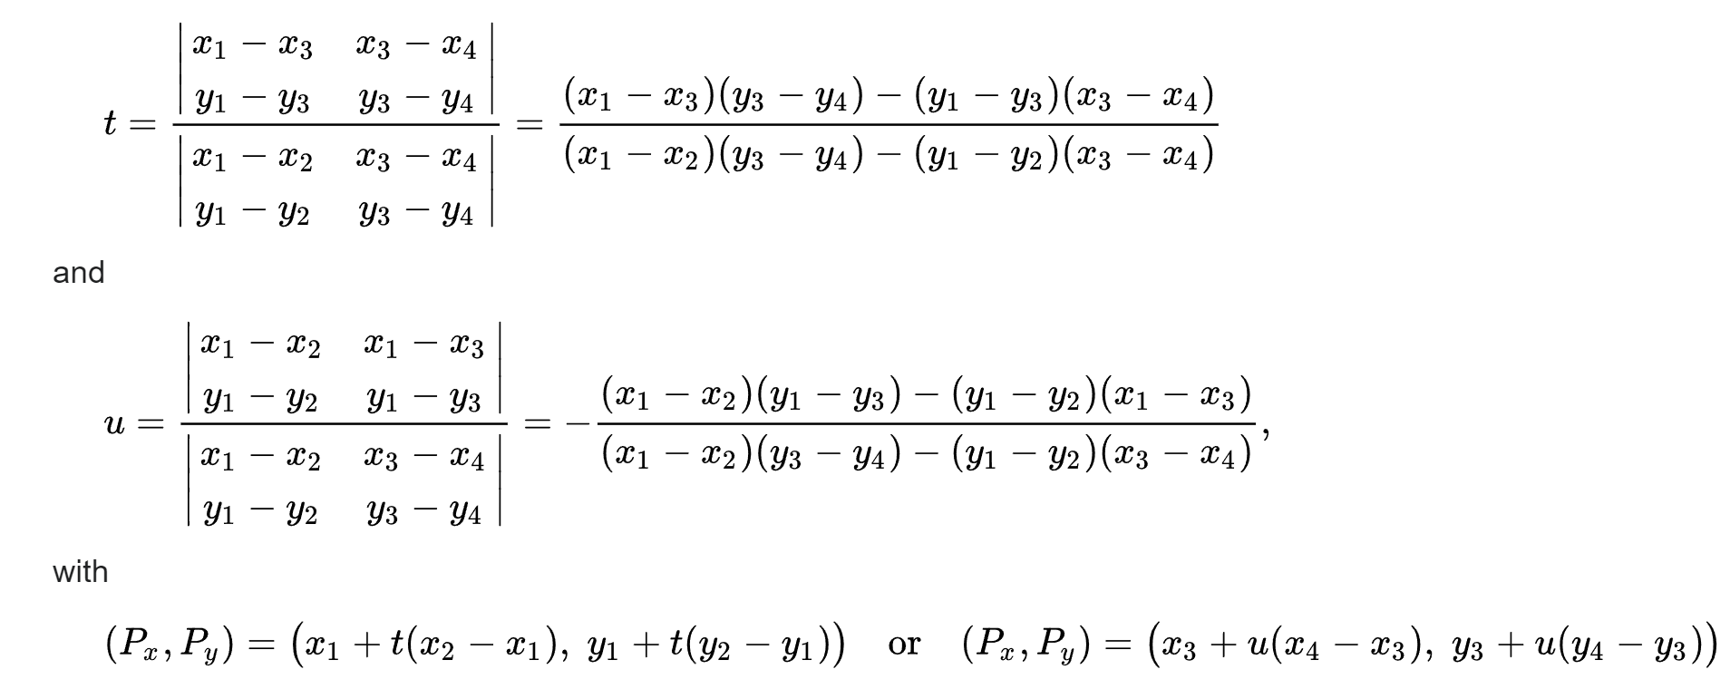
Intersection of 2 segments
(x4,y4)
https://en.wikipedia.org/wiki/Line%E2%80%93line_intersection
(x2,y2)
(x1,y1)
(xI,yI)
denominator
(x3,y3)
// Calculate the intersection point of two line segments
public static double[] calculateIntersection(double x1, double y1, double x2, double y2,
double x3, double y3, double x4, double y4) {
double[] intersection = new double[2];
double denominator = (x1 - x2) * (y3 - y4) - (y1 - y2) * (x3 - x4);
// Check if the lines are parallel (denominator is zero)
if (denominator == 0) {
return null; // No intersection
}
double t = ((x1 - x3) * (y3 - y4) - (y1 - y3) * (x3 - x4)) / denominator;
double u = -((x1 - x2) * (y1 - y3) - (y1 - y2) * (x1 - x3)) / denominator;
// Check if the intersection point is within the line segments
if (t >= 0 && t <= 1 && u >= 0 && u <= 1) {
intersection[0] = x1 + t * (x2 - x1);
intersection[1] = y1 + t * (y2 - y1);
return intersection;
} else {
return null; // Intersection is outside the line segments
}
}

Slide 29
Graphical representation – drawing needle
(0,0) – (0,0)
(width, 0)
(dX, dY)
maxAmplitude = 2^{bitPerFrame-1}
μ = (maxAngle-minAngle)
α = minAngle + amplitude * μ / maxAmplitude
X = xC + cos(α) * needleLength
Y = yC + sin(α) * needleLength
(xI, YI) = calculateIntersection(0,height, width,height, xC,yC, X,Y)
… if null → (xC, yC)
(dX, dY) = ( X * dWidth/width, Y * dHeight/height )
(dXi, dYi) = ( xI * dWidth/width, yI * dHeight/height )
Draw area
(dXi, dYi)
(dWidth, dHeight)
μ
(X, Y)
0
α
max
image
(xI, yI)
(0, height)
(width, height)
(xC, yC)

Slide 30
Smooth move
Refresh every 0,02s (1/50s = 50Hz) (do not wait for full buffer)
Define maximum pixels change up and down for each call (maxUpSpeed, maxDownSpeed)
Reach next measure progressively

Slide 31
Needle inertia
downSpeed
upSpeed

Slide 32
Avoid Flickering
if (segment != null) {
Platform.runLater(() -> {
needle.setStartX(segment[0]);
needle.setStartY(segment[1]);
needle.setEndX(segment[2]);
needle.setEndY(segment[3]);
needle.setVisible(true);
});
} else {
needle.setVisible(false);
}
https://stackoverflow.com/questions/34345019/javafx-animations-are-flickering
https://stackoverflow.com/questions/64291358/how-to-enable-platform-runlater-within-method

Slide 33
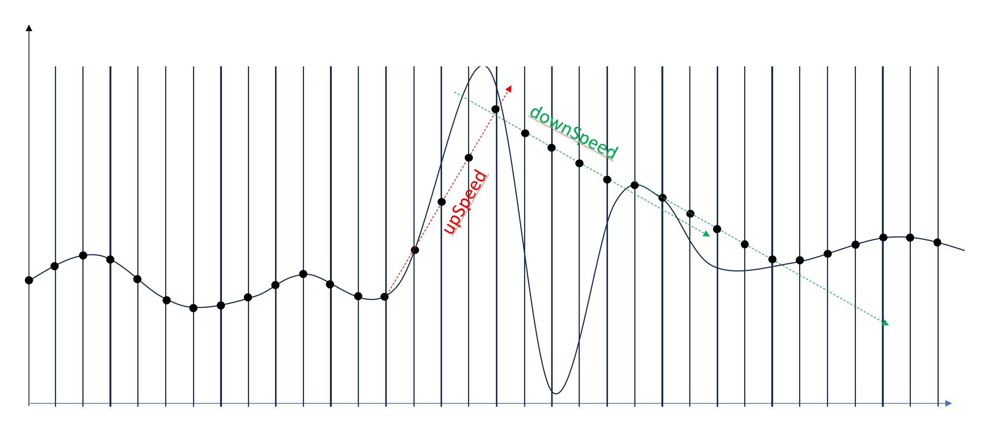
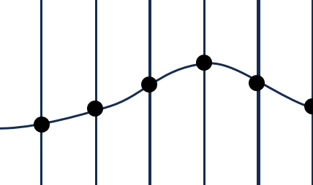
Smoothing

Slide 34
Background design

Slide 35
Background
-7
-5
-3
-1
0
-10
⁺1
⁺2
-20
⁺3
P O W E R L E V E L
D E C I B E L S

Slide 36
Background
-7
-5
-3
-1
0
-10
⁺1
⁺2
-20
⁺3
P O W E R L E V E L
D E C I B E L S

Slide 37
Background
-7
-5
-3
-1
0
-10
⁺1
⁺2
-20
⁺3
P O W E R L E V E L
D E C I B E L S

Slide 38
Background - blue
-7
-5
-3
-1
0
-10
⁺1
⁺2
-20
⁺3
P O W E R L E V E L
D E C I B E L S

Slide 39
-5
-3
-1
-7
0
-10
⁺1
⁺2
-20
⁺3
P O W E R L E V E L
D E C I B E L S

Slide 42
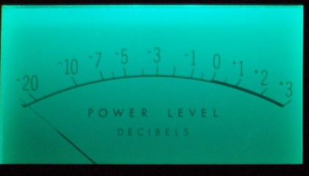
Background - green
-7
-5
-3
-1
0
-10
⁺1
⁺2
-20
⁺3
P O W E R L E V E L
P O W E R L E V E L
D E C I B E L S
D E C I B E L S

Slide 43
-5
-3
-1
-7
0
-10
⁺1
⁺2
-20
⁺3
P O W E R L E V E L
D E C I B E L S

Slide 44
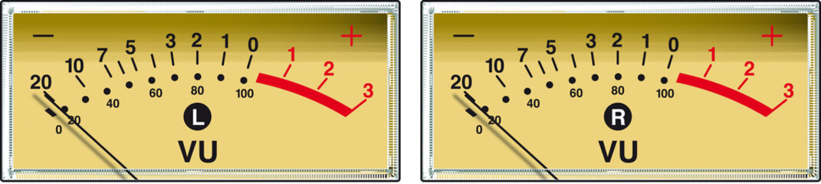
Background - yellow
-7
-5
-3
-1
0
-10
⁺1
⁺2
-20
⁺3
P O W E R L E V E L
P O W E R L E V E L
D E C I B E L S
D E C I B E L S

Slide 45
-5
-3
-1
-7
0
-10
⁺1
⁺2
-20
⁺3
P O W E R L E V E L
D E C I B E L S

Slide 46
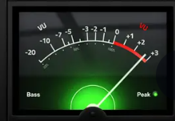
Background - black
-7
-5
-3
-1
0
-10
⁺1
⁺2
-20
⁺3
P O W E R L E V E L
P O W E R L E V E L
D E C I B E L S
D E C I B E L S

Slide 47
-5
-3
-1
-7
0
-10
⁺1
⁺2
-20
⁺3
P O W E R L E V E L
D E C I B E L S

Slide 48
Background - white
-7
-5
-3
-1
0
-10
⁺1
⁺2
-20
⁺3
P O W E R L E V E L
P O W E R L E V E L
D E C I B E L S
D E C I B E L S

Slide 49
-5
-3
-1
-7
0
-10
⁺1
⁺2
-20
⁺3
P O W E R L E V E L
D E C I B E L S

Slide 50
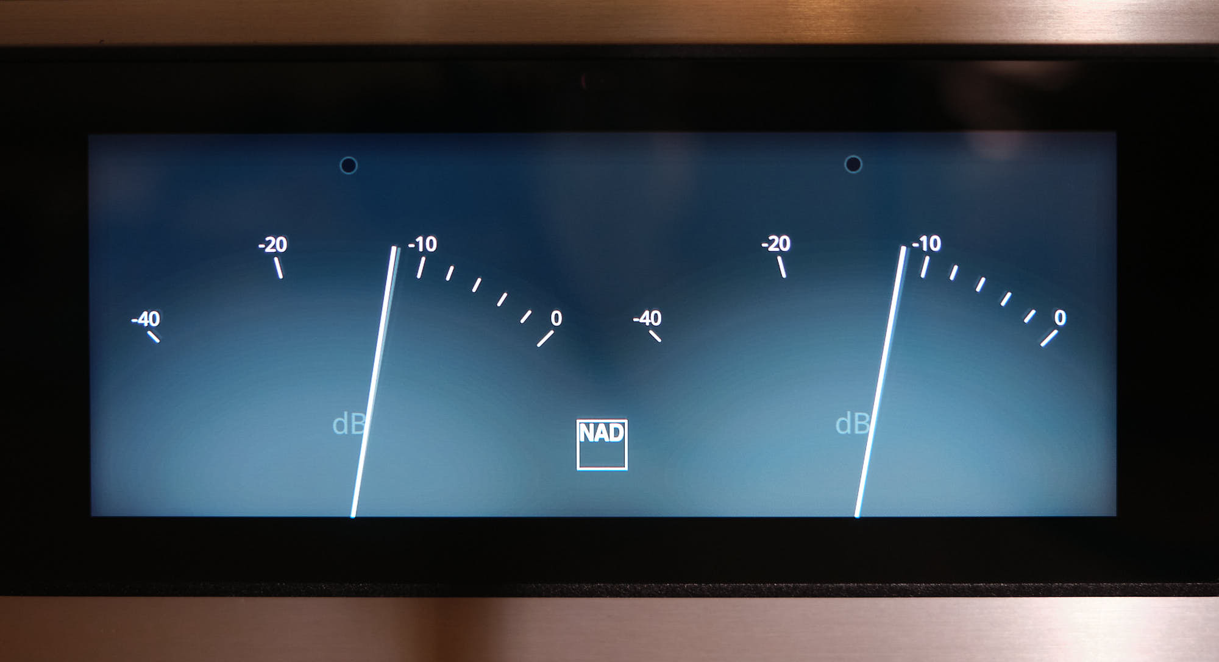
NAD - Grey
-10
-20
-40
0
NAD
dB

Slide 51
-10
-20
-40
0
NAD
dB

Slide 52
NAD - white
-10
-20
-40
0
NAD
dB

Slide 53
-10
-20
-40
0
NAD
dB

Slide 55
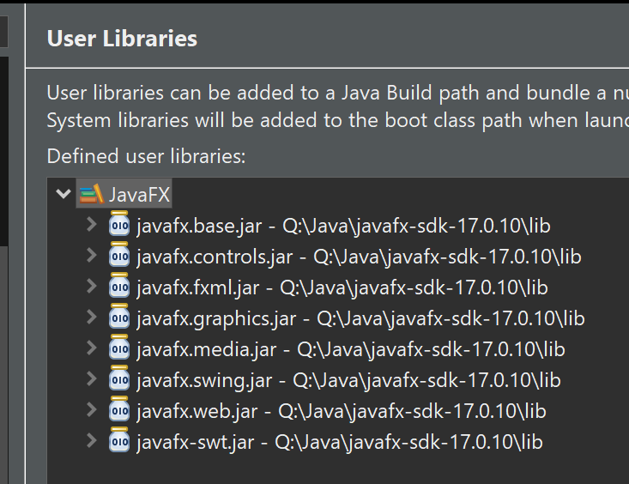
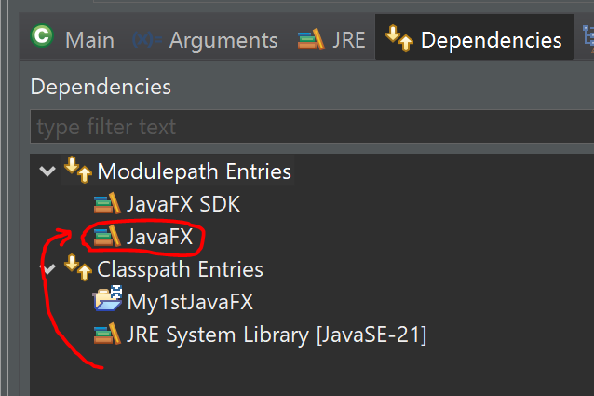
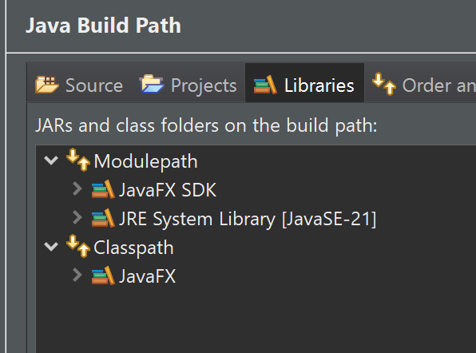
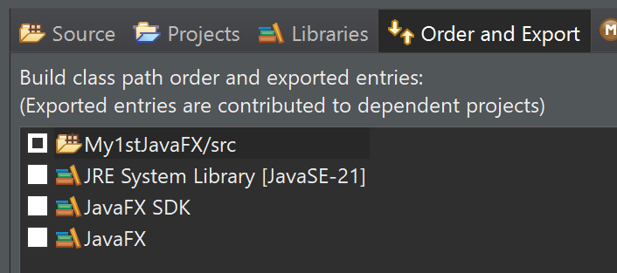
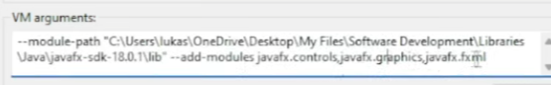
JavaFX
Integration with Eclipse: cf. https://www.youtube.com/watch?v=bk28ytggz7E
https://www.youtube.com/watch?v=nz8P528uGjk
Download SKD: https://openjfx.io/
:
! Delete module-info from generated project

Slide 56
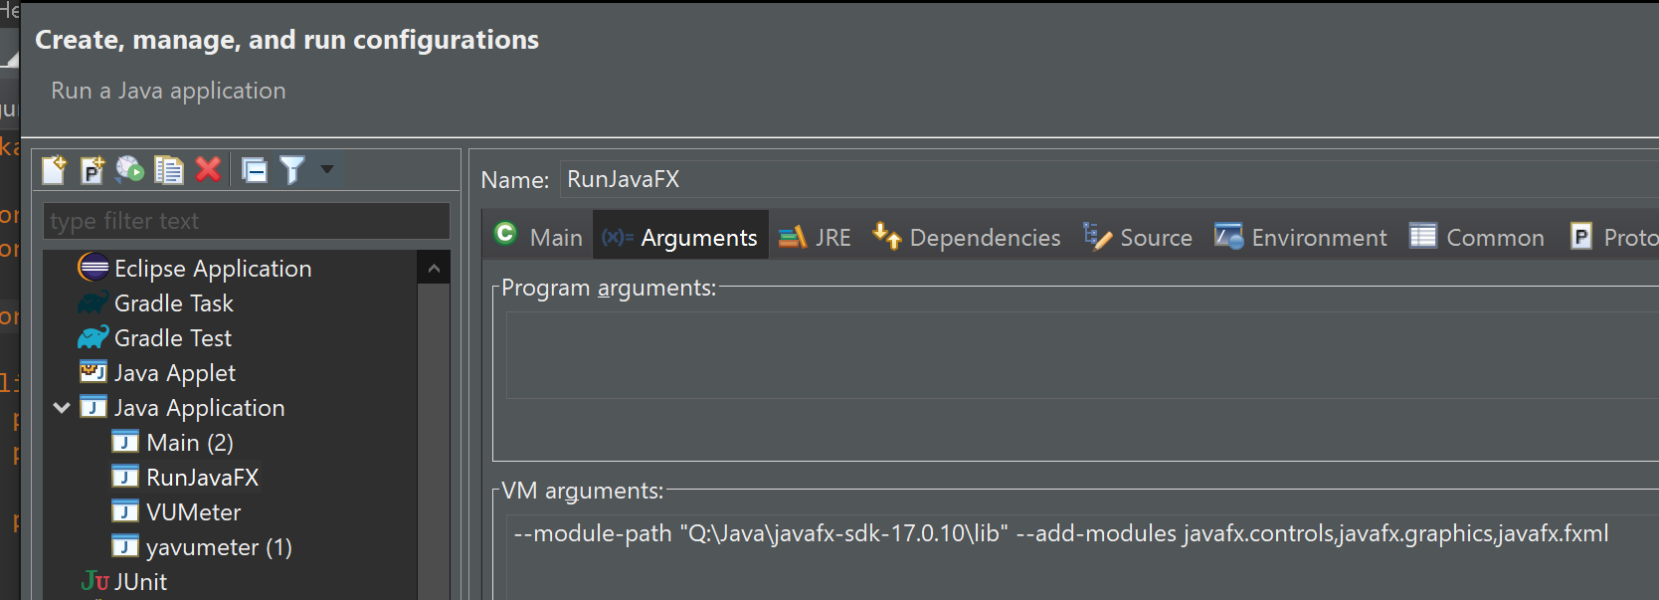
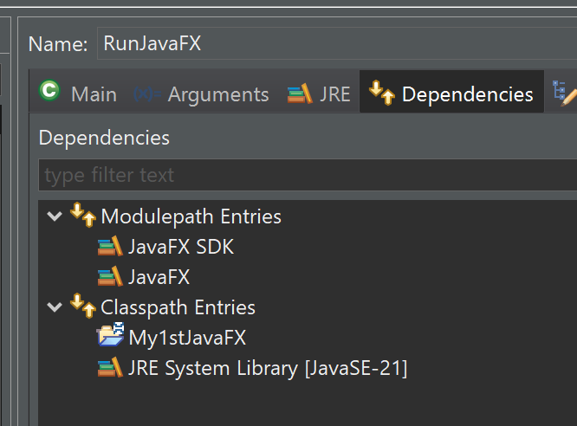
Run configuration

Slide 57

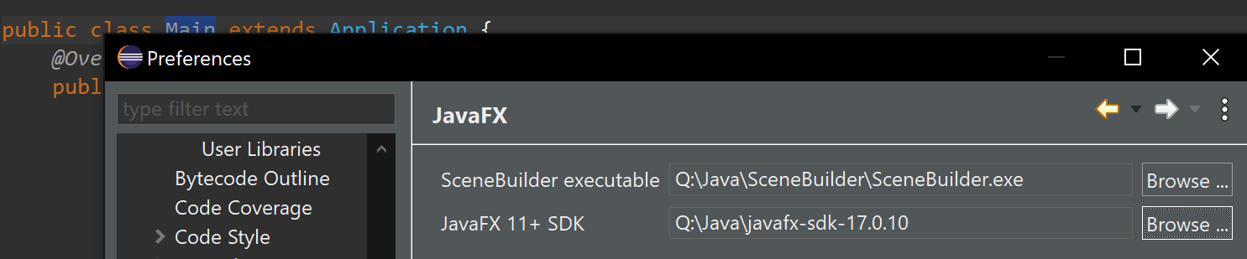
Screen design – Scene Builder
Install:
https://www.youtube.com/watch?v=cfGTJVVcWvE&list=PLpFneQZCNR2ktqseX11XRBc5Kyzdg2fbo
Use:
https://www.youtube.com/watch?v=HBBtlwGpBek
https://www.youtube.com/watch?v=q5A-qW2eGKs&list=PLpFneQZCNR2ktqseX11XRBc5Kyzdg2fbo&index=2

Slide 58
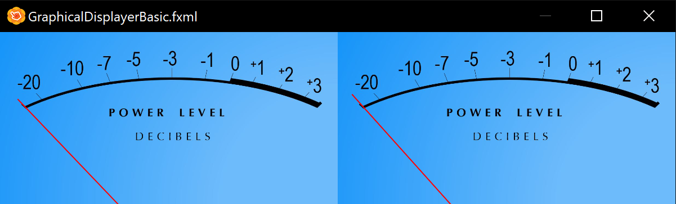
First result…

Slide 59
UML
gitmind
https://gitmind.com/app/docs/f64imf33

Slide 60
Release
Build, Release, Publish, install on another machine from github

Slide 61
OSGi
To evaluate..

Slide 62
Step 4 – C/S model (angular+Spring)
GUI Framework: Angular
Server : swing
TODO

Slide 63
Step 5 – Mobile
Reverse client/server model (like X-windows)?
Framework: ??
TODO

Slide 64
Bypass VoiceMeter
Integrate custom Java interface with some C++ library or custom dev to directly access a selected output device (target mixer) instead of redirecting output with VoiceMeter to a virtual microphone

